Slide 1
What Is Design Thinking?
An introduction to the human-centered, iterative process that powers innovation and problem-solving across industries.
Notes:
Welcome, and thank you for joining. Today, we're going to explore Design Thinking—a mindset and methodology that places humans at the center of innovation. It’s not just for designers—it’s a powerful framework for solving complex problems across any industry.

Slide 2

Why Design Thinking Matters
Design Thinking fosters creativity, collaboration, and empathy—key drivers for business growth, innovation, and customer satisfaction.
Notes:
Traditional problem-solving often jumps straight to solutions. Design Thinking, however, starts by asking the right questions. It helps organizations unlock creativity, improve collaboration, and ultimately build products, services, and experiences that people truly value.

Slide 3
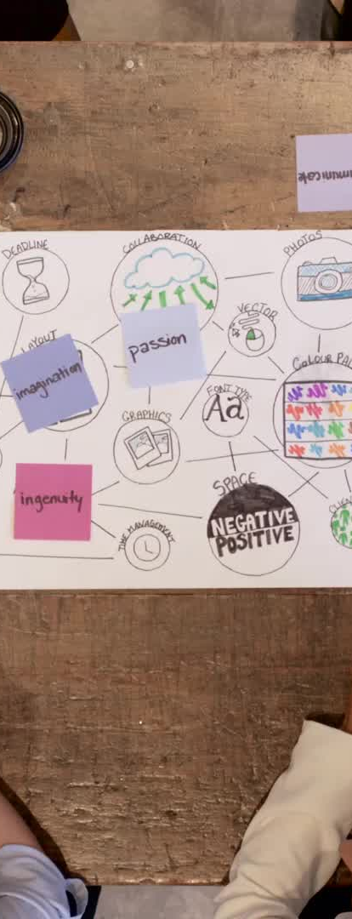
The Five Phases of Design Thinking
1. Empathize
2. Define
3. Ideate
4. Prototype
5. Test
These stages help teams understand problems deeply and build better solutions.
Notes:
These five phases form the foundation of Design Thinking:
Empathize – Understand your users.
Define – Frame the real problem.
Ideate – Generate bold ideas.
Prototype – Make your ideas tangible.
Test – Learn what works, then iterate. We'll explore each briefly today.

Slide 4
Empathize
Understand users through observation, interviews, and immersion. Gain insights into needs, behaviors, and motivations.
Notes:
Empathy is where it starts. You observe, engage, and listen to users. This isn’t just about data—it’s about seeing the world through their eyes. The goal is to uncover real needs, not just what people say they want.

Slide 5

Define
Synthesize findings to create clear problem statements. Frame the challenge with a user-centered lens.
Notes:
Once you understand the user’s world, you synthesize those insights. The Define phase turns scattered observations into a clear, actionable problem statement—often framed as a “How might we…” question that encourages possibility.

Slide 6
Ideate
Generate a wide range of creative ideas. Encourage divergent thinking and challenge assumptions.
Notes:
This is where creativity flows. In Ideation, teams explore a wide range of ideas—without judgment. The goal is to think beyond the obvious. Techniques like brainstorming, mind mapping, and provocations help teams push past assumptions.

Slide 7

Prototype
Create tangible representations of ideas. Use sketches, mockups, or models to explore and iterate quickly.
Notes:
Now we bring ideas to life. Prototyping is about speed and learning—not perfection. It could be a sketch, a model, or a storyboard. The key is to build something you can show to others and get feedback on.

Slide 8

Test
Gather feedback from real users. Refine and improve solutions based on what you learn.
Notes:
In the Test phase, you return to the users. You show them your prototype, gather reactions, and observe their behavior. Their feedback helps you iterate—refining the solution or even revisiting earlier stages. It's all about learning quickly and improving continually.

Slide 9
Design Thinking in Action
Used by global leaders like IBM, Airbnb, and IDEO. Enables teams to solve complex problems and deliver human-centered solutions.
Notes:
Design Thinking is used by some of the world’s most innovative companies: IBM uses it to accelerate enterprise transformation; Airbnb credits it for a major turnaround; and IDEO has built its entire practice around it. These organizations succeed by designing with people, not just for them.

Slide 10
Getting Started
Start small. Frame a challenge. Talk to your users. Embrace iteration. Make space for creativity in your corporate culture.
Notes:
You don’t need to transform overnight. Start small. Identify a challenge. Talk to users. Build a prototype. Run a test. The beauty of Design Thinking is its adaptability—it can start in one team and scale across an organization over time.

Slide 11
Thank You
Ready to bring Design Thinking into your organization?
Let's innovate—together.
Notes:
Thank you for joining. Design Thinking isn't a silver bullet—it’s a mindset. But if your organization embraces it, you’ll unlock more relevant, sustainable, and human-centered solutions. Let’s keep the conversation going.

